Slide 1
Research Computing Services
Unix Command Line
https://github.com/nuitrcs/commandlineworkshop
Christina Maimone
christina.maimone@northwestern.edu

Slide 2
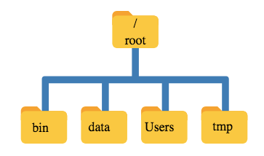

Slide 3

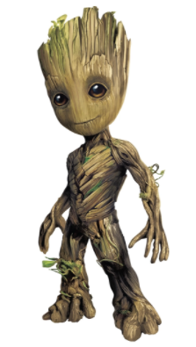
“Root”
a location: the base of the filesystem tree
/
a user: the superuser

Slide 4
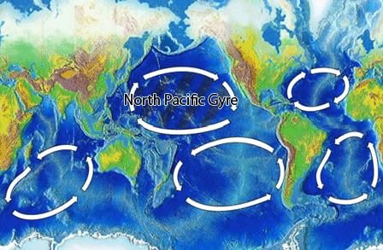
North Pacific Gyre
Great Pacific Garbage Patch

Slide 5
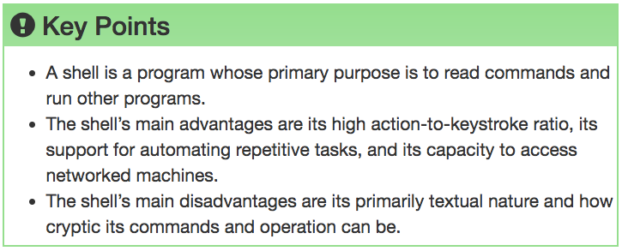

Slide 6

Navigating Files & Directories

Slide 7
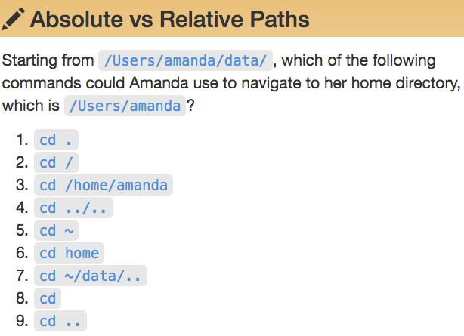
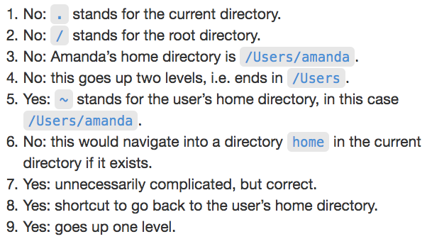


Slide 8
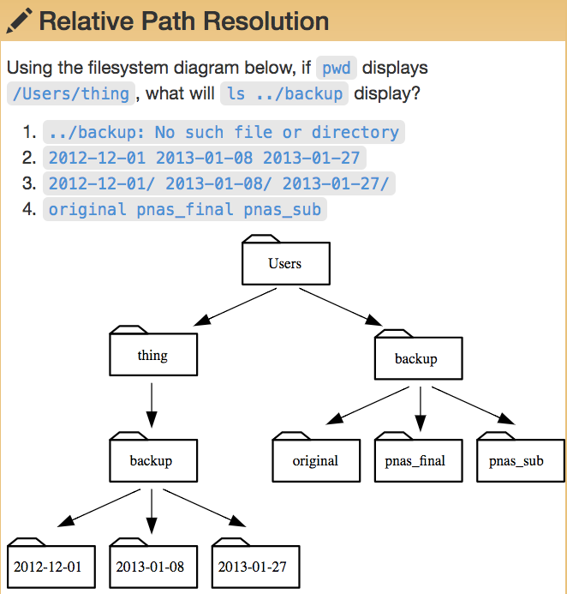

Slide 9
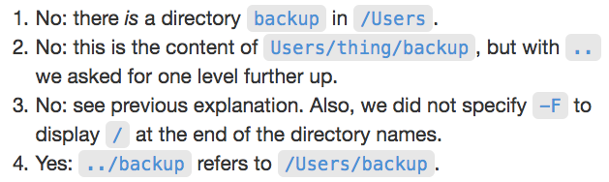
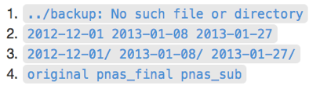

Slide 10
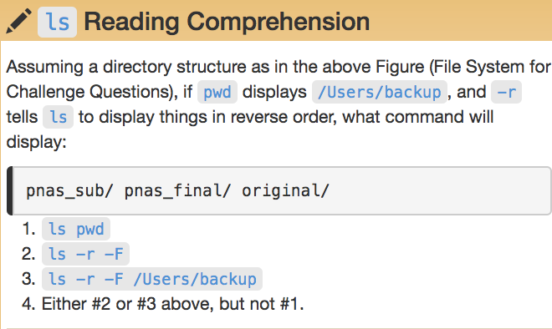
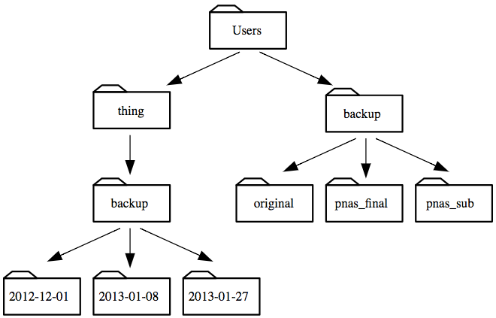

Slide 12
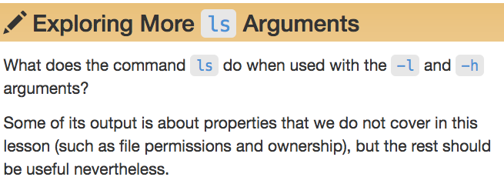
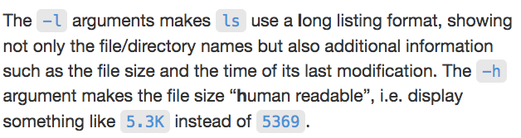

Slide 13
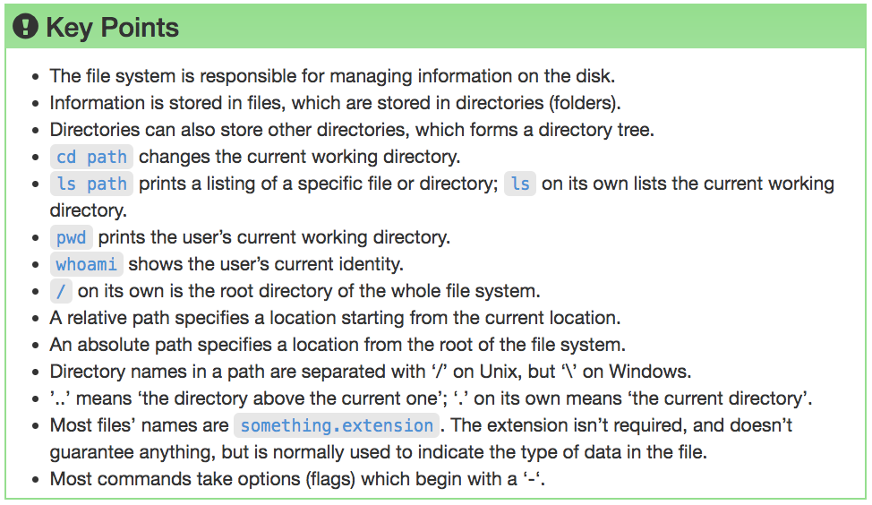

Slide 14
Working With Files & Directories

Slide 15
Good Names for Files & Directories
Don’t use whitespace (“my work”)
Don’t begin the name with a dash “-”
Don’t begin the name with a “.” unless you mean it
Use letters, numbers, “-”, “.”, “_”
If you need to use a filename with special characters,
surround the name in quotes (“- a bad name !”)

Slide 16
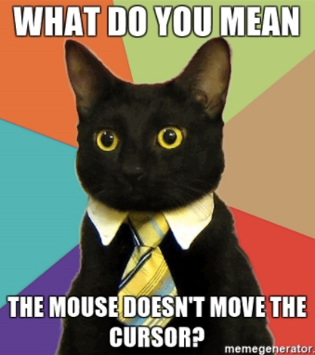
text editor: nano
type “nano <filename>” this will open the named file for editing or create it if it doesn’t exist
type your text: the mouse will not move the cursor - navigate with the arrow keys
save and quit: commands are on the bottom of the screen - the “^” stands for “control”

Slide 17
text editor: vi/vim
On command line: “vi test.txt”
You land in command mode
To enter insert mode: “i” where the cursor is; “o” inserts one line below that
Navigate with arrow keys
To exit insert mode: “esc”
To save: “:w”
To exit: “:q”
To exit without saving: “q!”

Slide 18
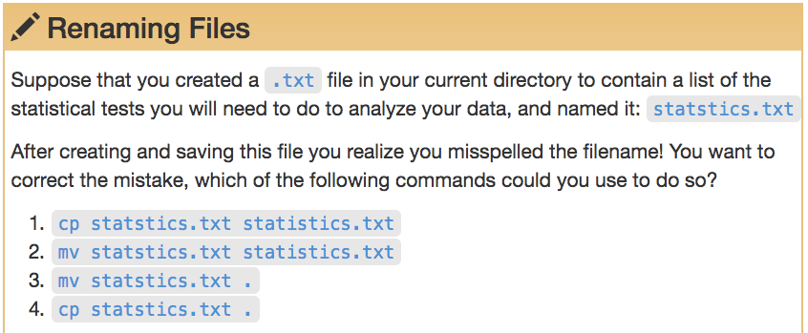
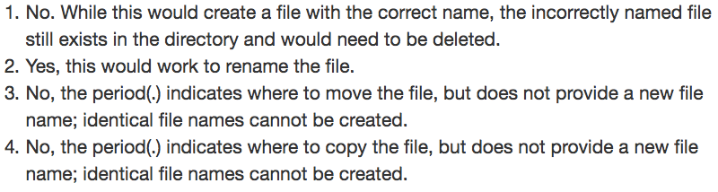

Slide 19
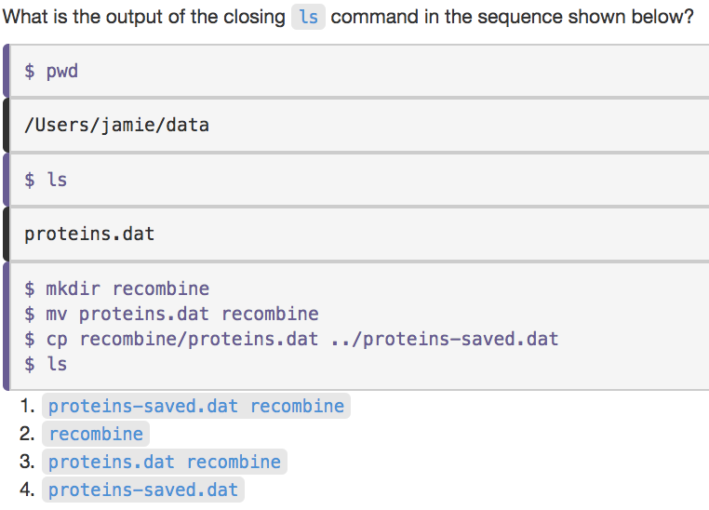

Slide 20
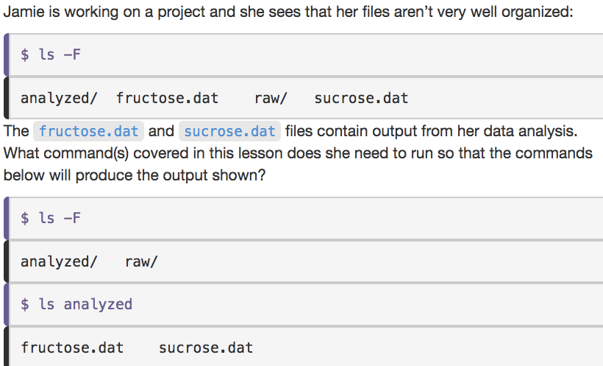

Slide 21
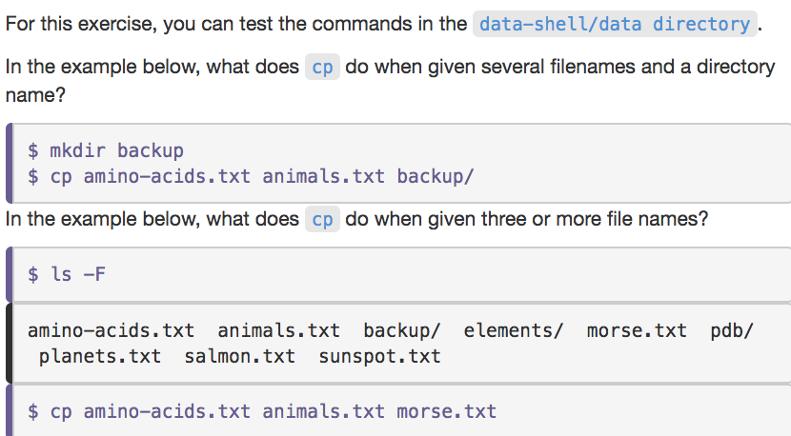
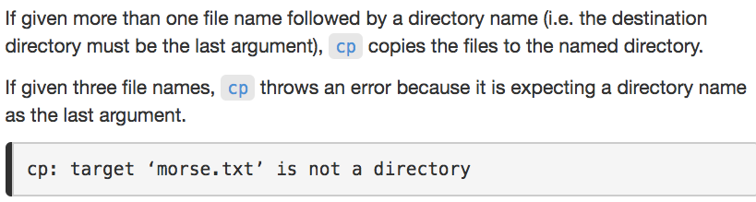

Slide 22
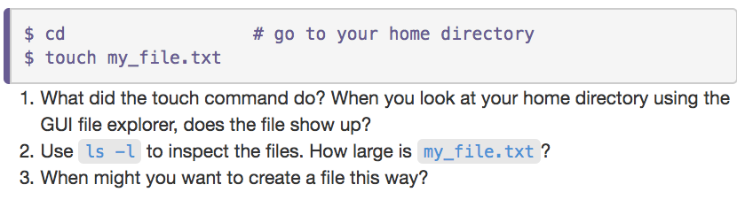

Slide 23
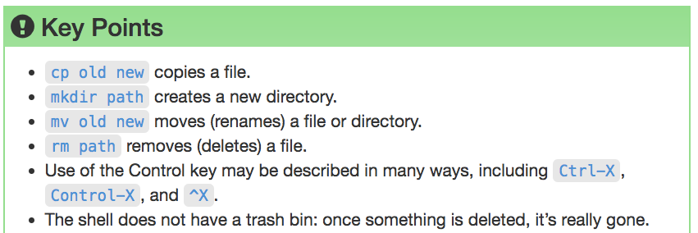

Slide 24
Pipes & Filters

Slide 25
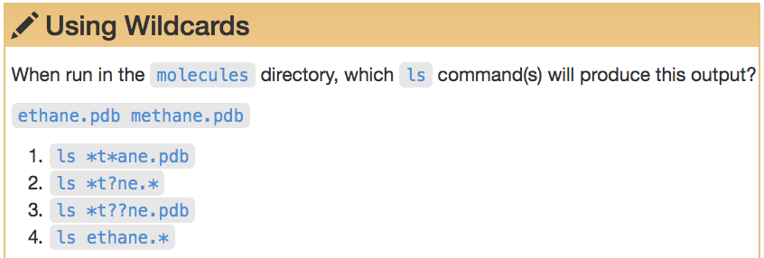
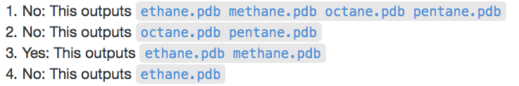

Slide 26
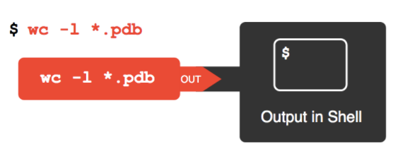

Slide 27
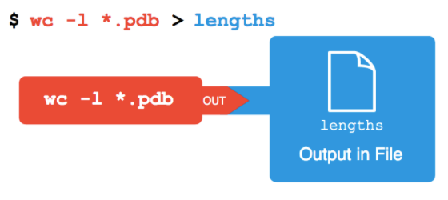

Slide 28
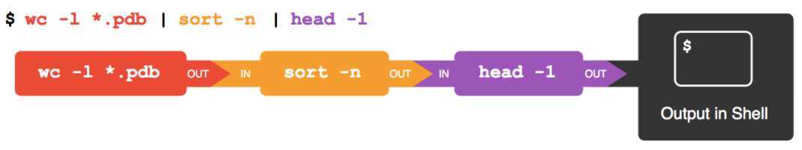

Slide 29
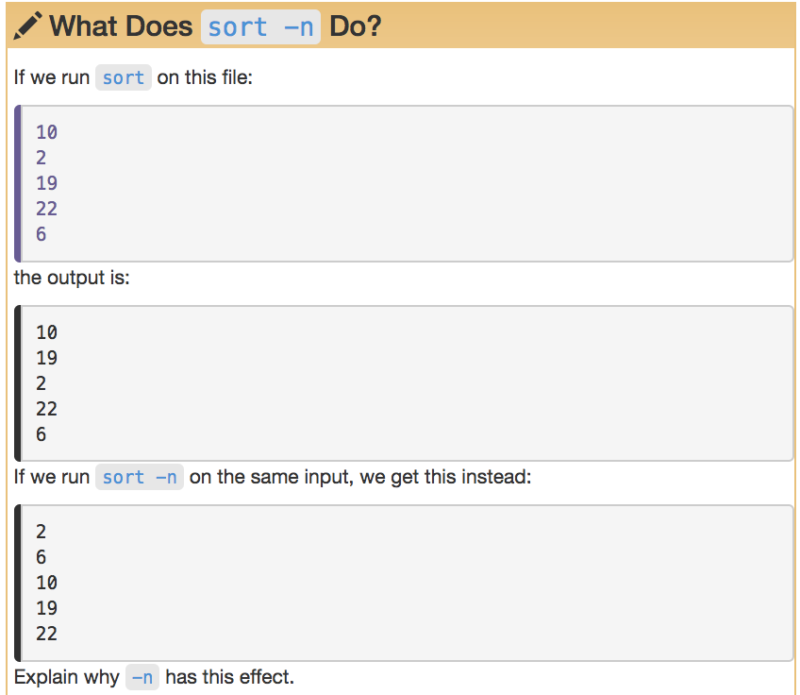

Slide 30
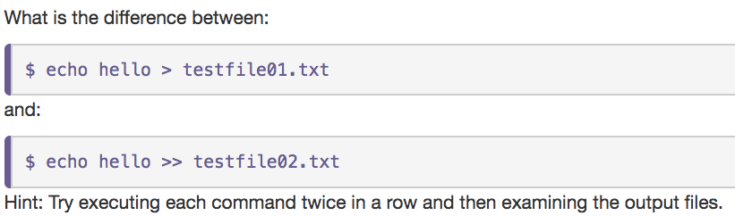

Slide 31
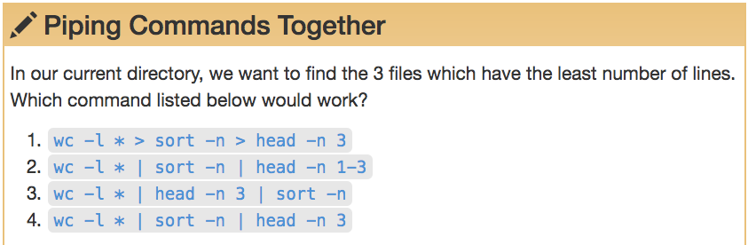
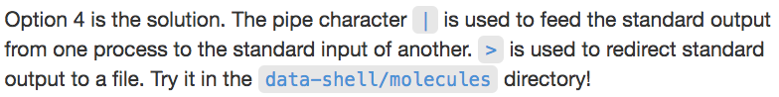

Slide 32
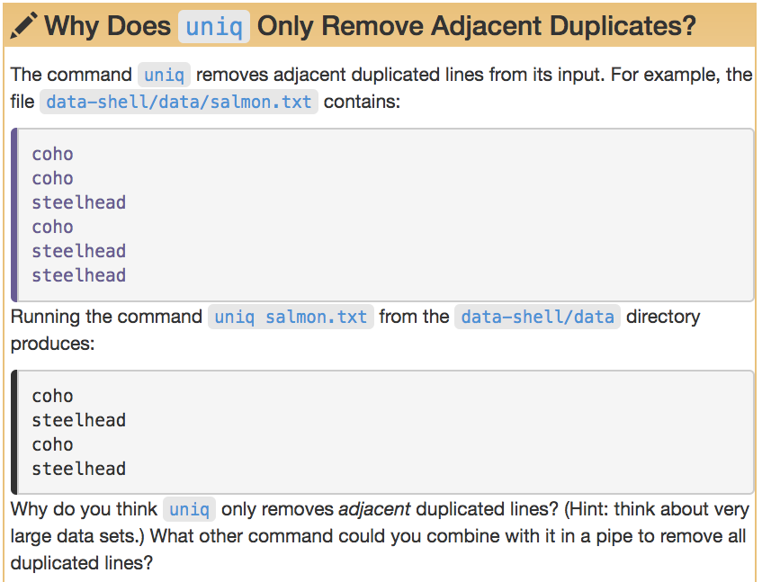

Slide 33
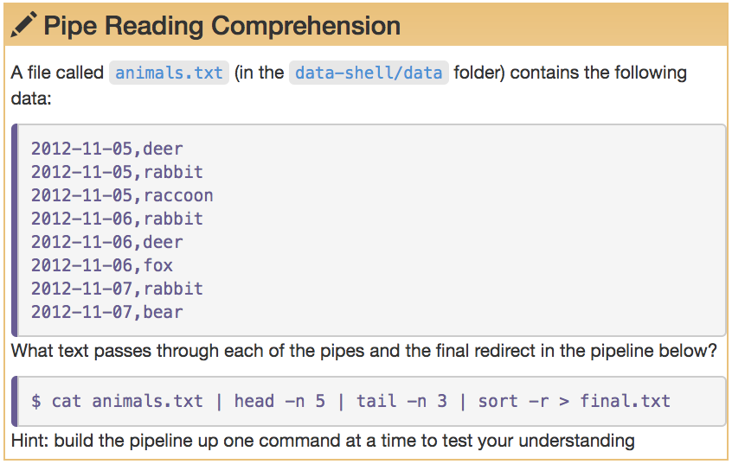

Slide 34
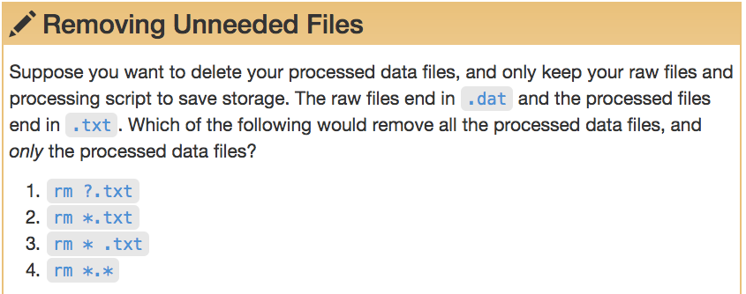

Slide 35
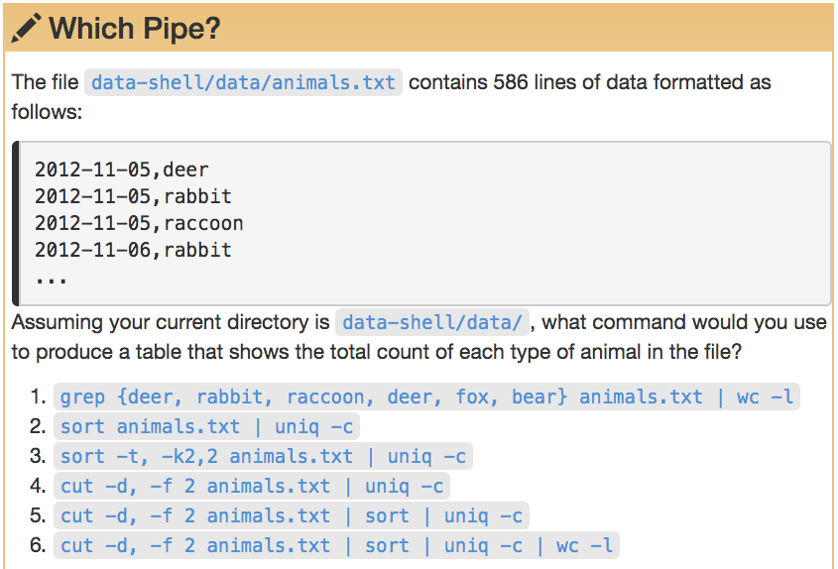

Slide 36
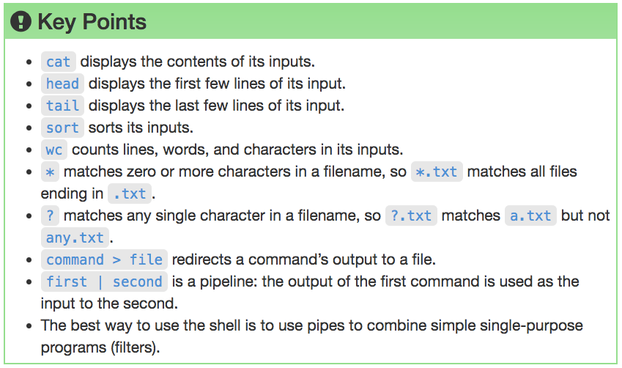

Slide 37
Loops

Slide 38
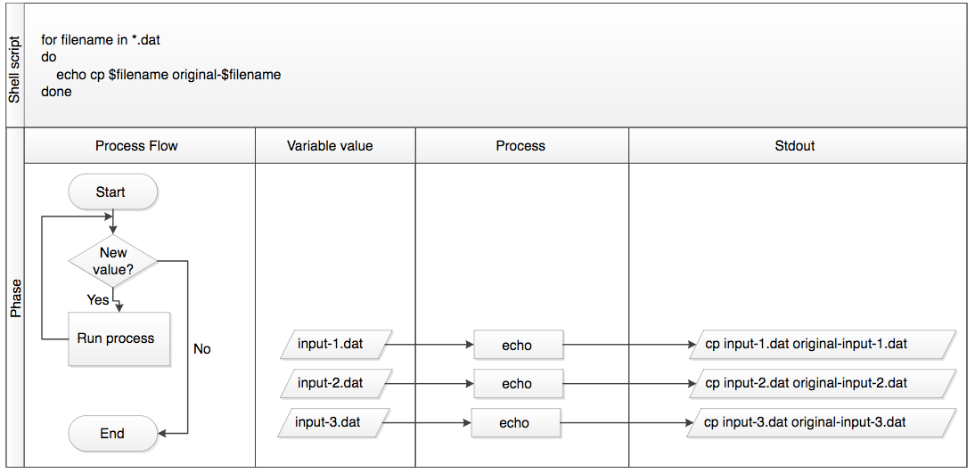
What did the loop do?

Slide 39
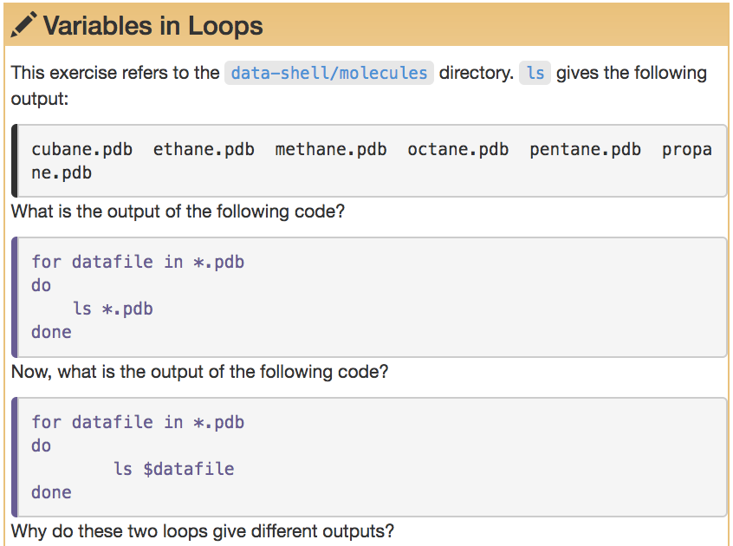

Slide 40
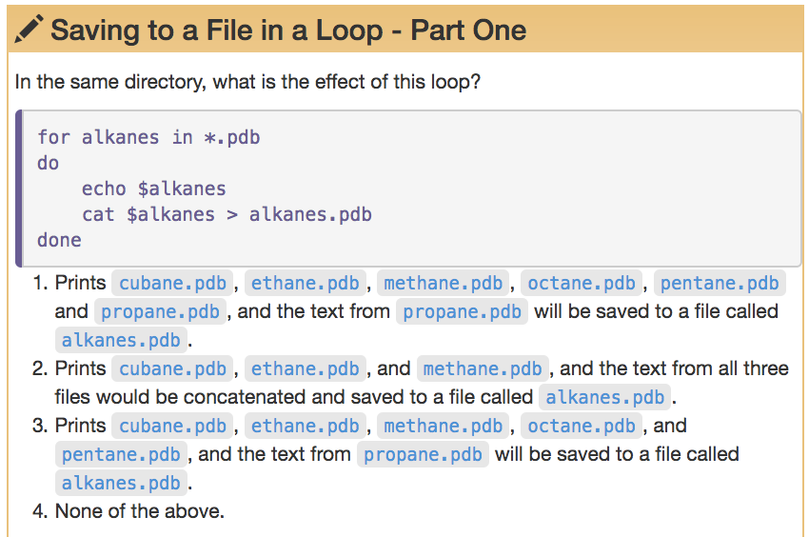

Slide 41
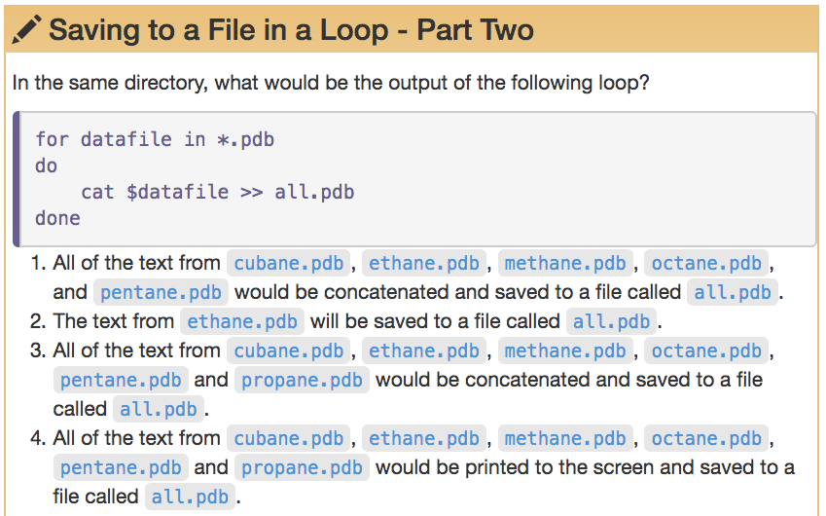

Slide 42
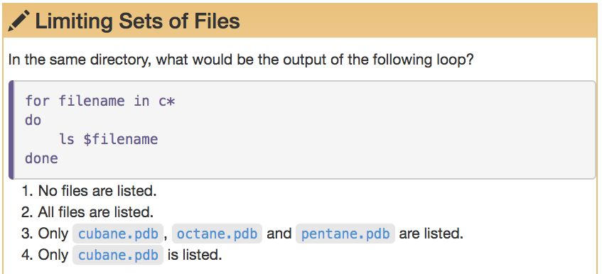

Slide 43
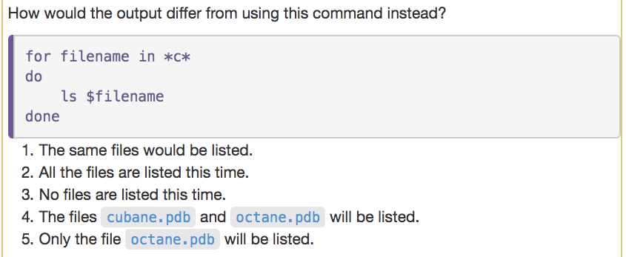

Slide 44
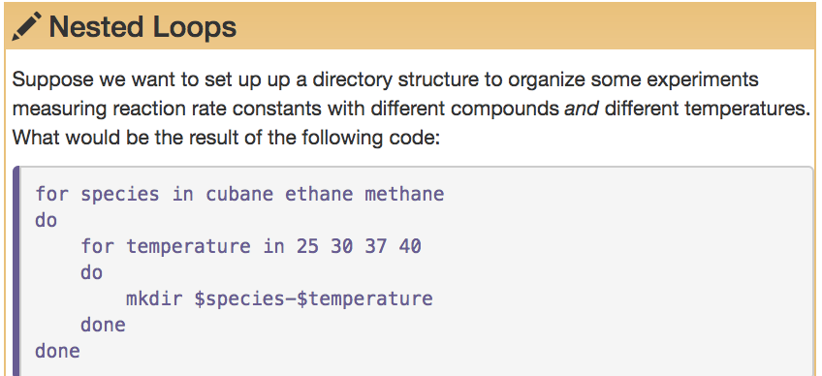
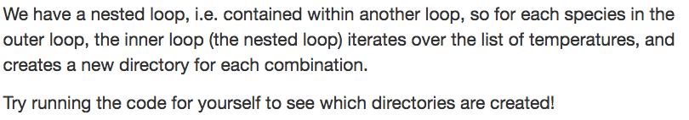

Slide 45
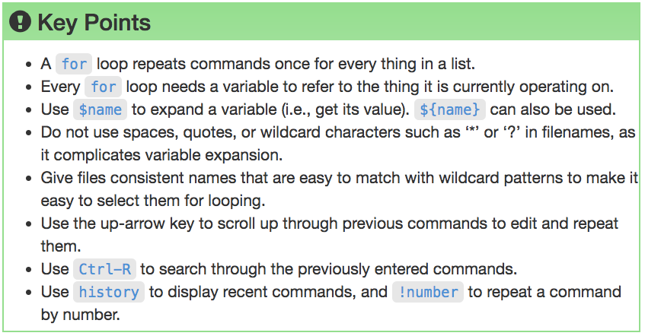

Slide 46
Shell Scripts

Slide 47
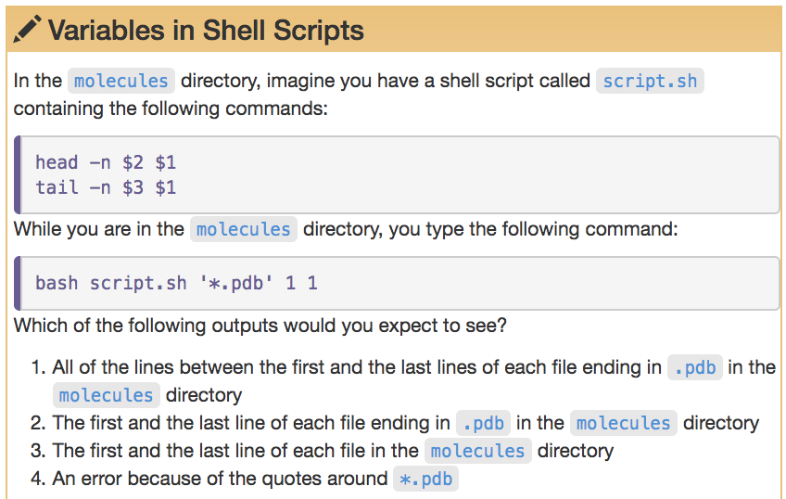

Slide 48
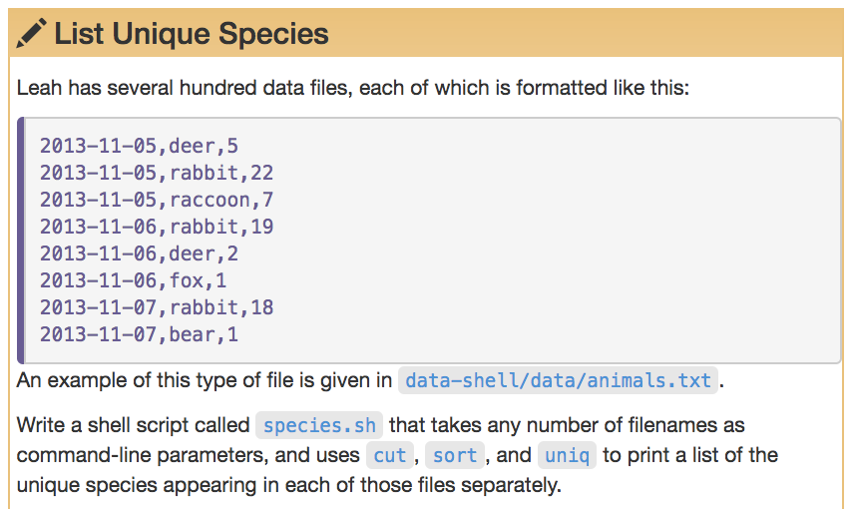
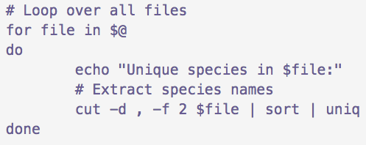

Slide 49
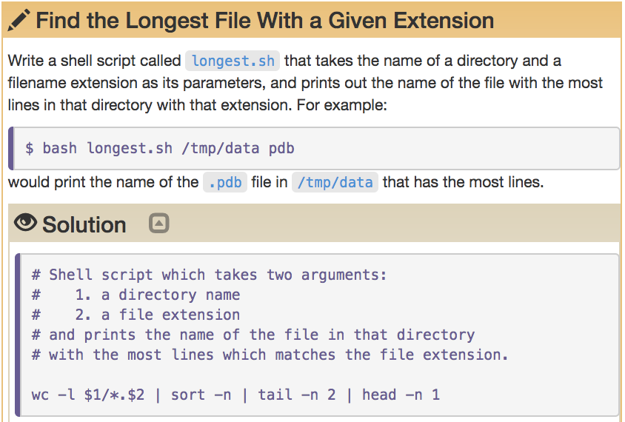

Slide 50


Slide 51
Finding Things

Slide 52


Slide 53


Slide 54


Slide 55


Slide 56
Research Computing Services
Unix Command Line
https://github.com/nuitrcs/commandlineworkshop
Janna Nugent: janna.nugent@northwestern.edu
Alper Kinaci: akinaci@northwestern.edu
Christina Maimone: christina.maimone@northwestern.edu

